Slide 1
AFSCME Local 88 DEI 2021 Recap

Slide 2
Microaggressions Planning Team
Created recommendations for how AFSCME Local 88 will recognize and respond to workplace microaggressions on behalf of all AFSCME Local 88 members
The Executive Board approved the recommendations in August 2021
Begin recruitment for microaggression response team members
Thank you:
Jackie Tate, Joslyn Baker, Wendy Lin-Kelly, Joey Jordan, Jason Barnstead-Long, Robin Davis, Mecca Scott, Celeste Jones, Debra Lindsay
Notes:
Joey and Mecca will be co-leading the microaggressions response team
Have suggested changes to contract language and new bargaining topics related to article 24

Slide 3
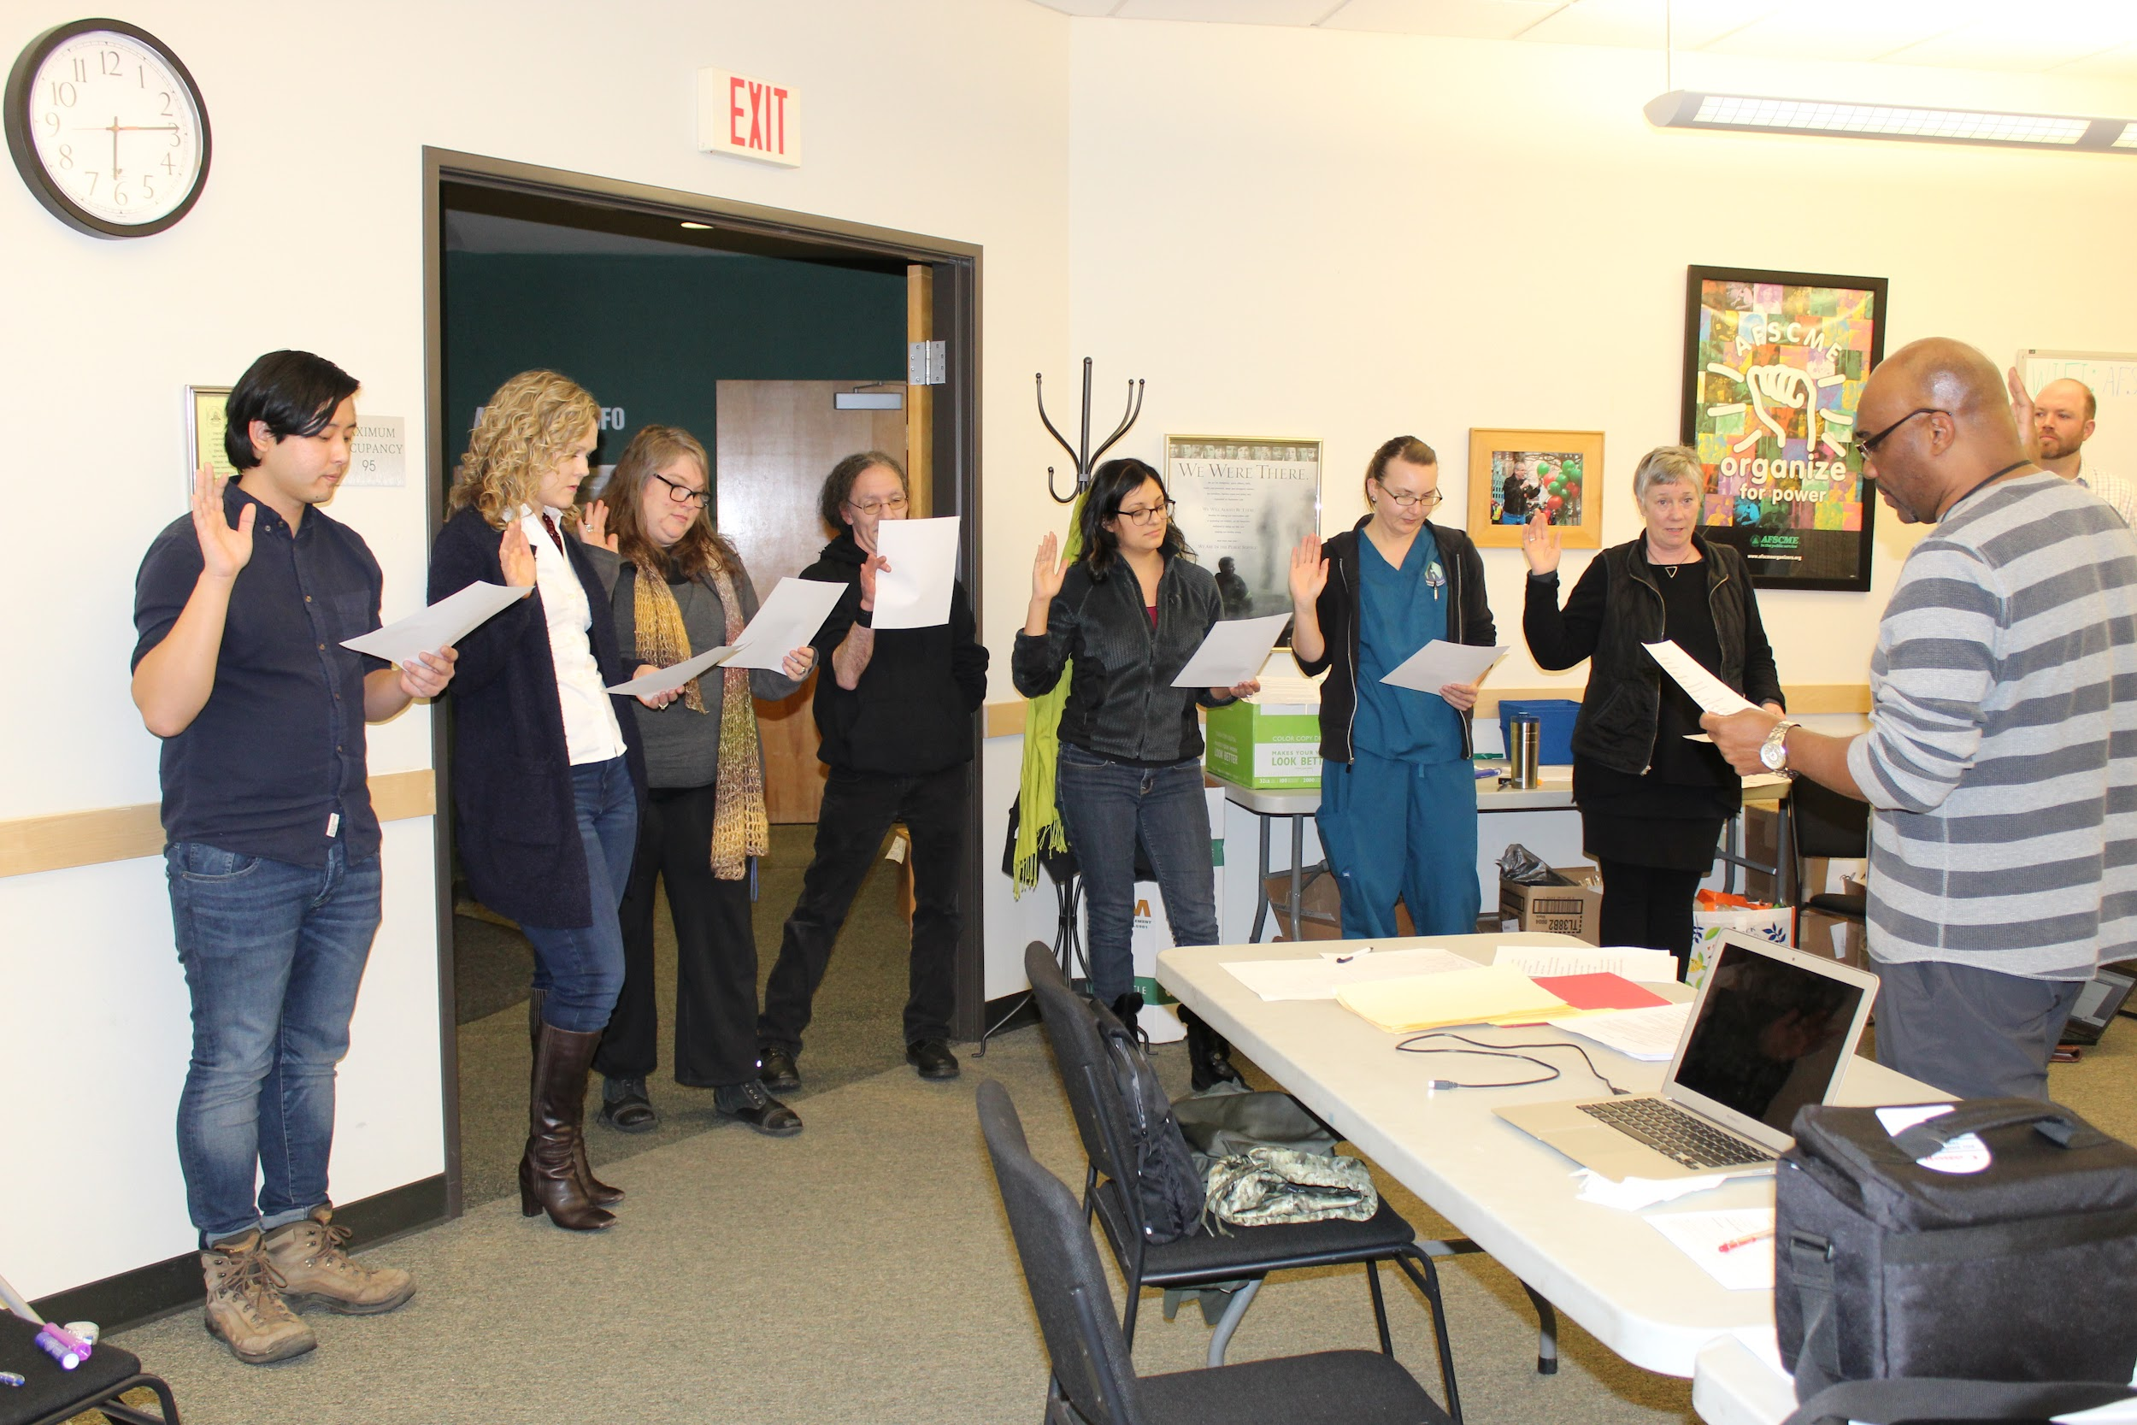
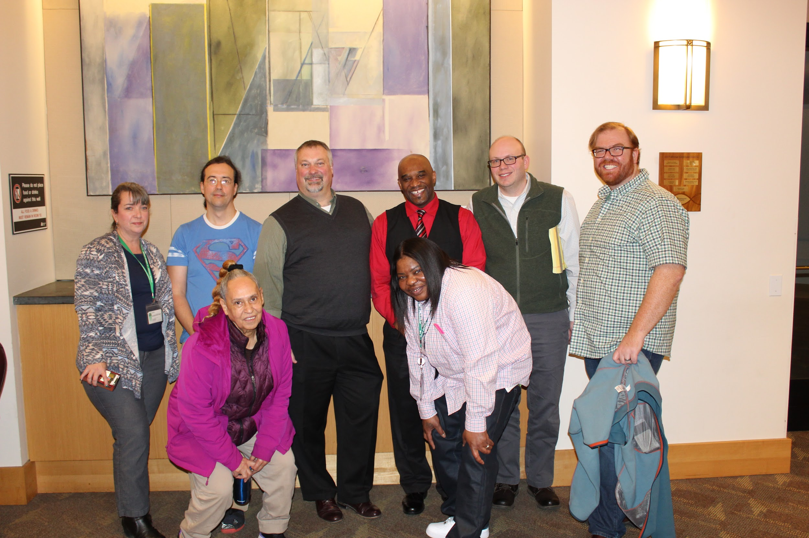
Constitution & Policies
Created a constitution and policies committee to update these documents with current positions and processes of AFSCME Local 88
Thank you:
Matt Davis, Jackie Tate, Joslyn Baker, Jackie Vitron, Debe Hobbs, Jeanne Ramsten, Lakeesha Dumas, Tom Newsom, Gordon Long, Percy Winters Jr.,Mecca Scott, Celeste Jones, Eben Pullman

Slide 4
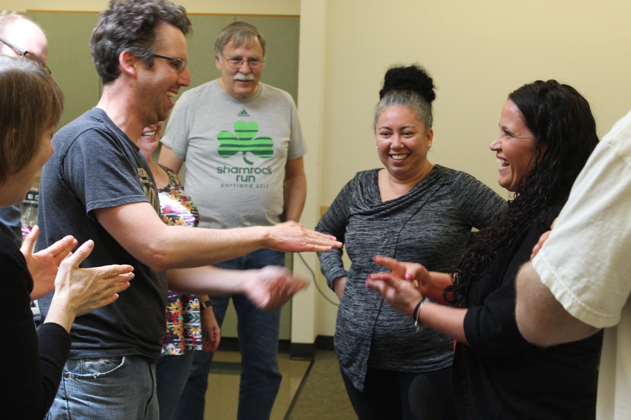
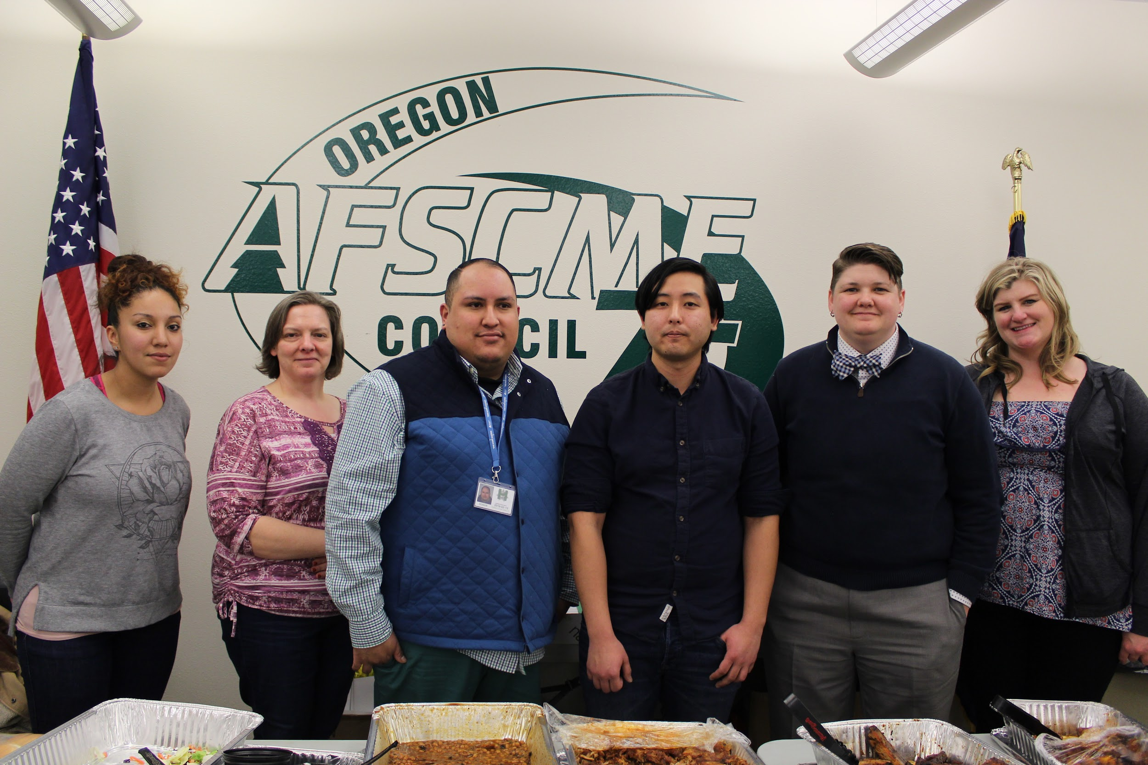
Relationship Building
Office Hours- Pilot
Met with Employee Resource Groups to build relationships, listen to immediate and long-term concerns and find ways to get more involved
Created a space for members to ask questions and bring up up concerns related to diversity, equity and Inclusion; bargaining, steward, trainings etc…
Notes:
Creating space
ERG’s- EOC, FAM, I&R, IDEA, Veterans, Reached out PRISM, QTPOC and VAN
We has several ERG members sit in on the telework and vaccine bargaining teams over the summer/ early Fall, delegates and voted onto the bargaining team
Talk about mtg with I&R- Telework concerns and we brought this into telework bargaining
Start up office hours again next month, February and will have a theme and leave space for general questions at the end. Plan to have a council rep or someone from leadership to help answer questions depending on the topic.
Thank Celeste for brainstorming this idea with me

Slide 5
Communications
Created an active communications committee
Created a communications plan
Ensured the Update of our AFSCME Local 88 website (DEI Page)
Thank you:
Percy Winters Jr., Gayle Wilson, Kaytee Evans, Manuel Arellano, Michael Hanna, Eben Pullman,Penelope Morton, Jaime Christianson, Karin Sandwick, Lela Clay, Joslyn Baker

Slide 6
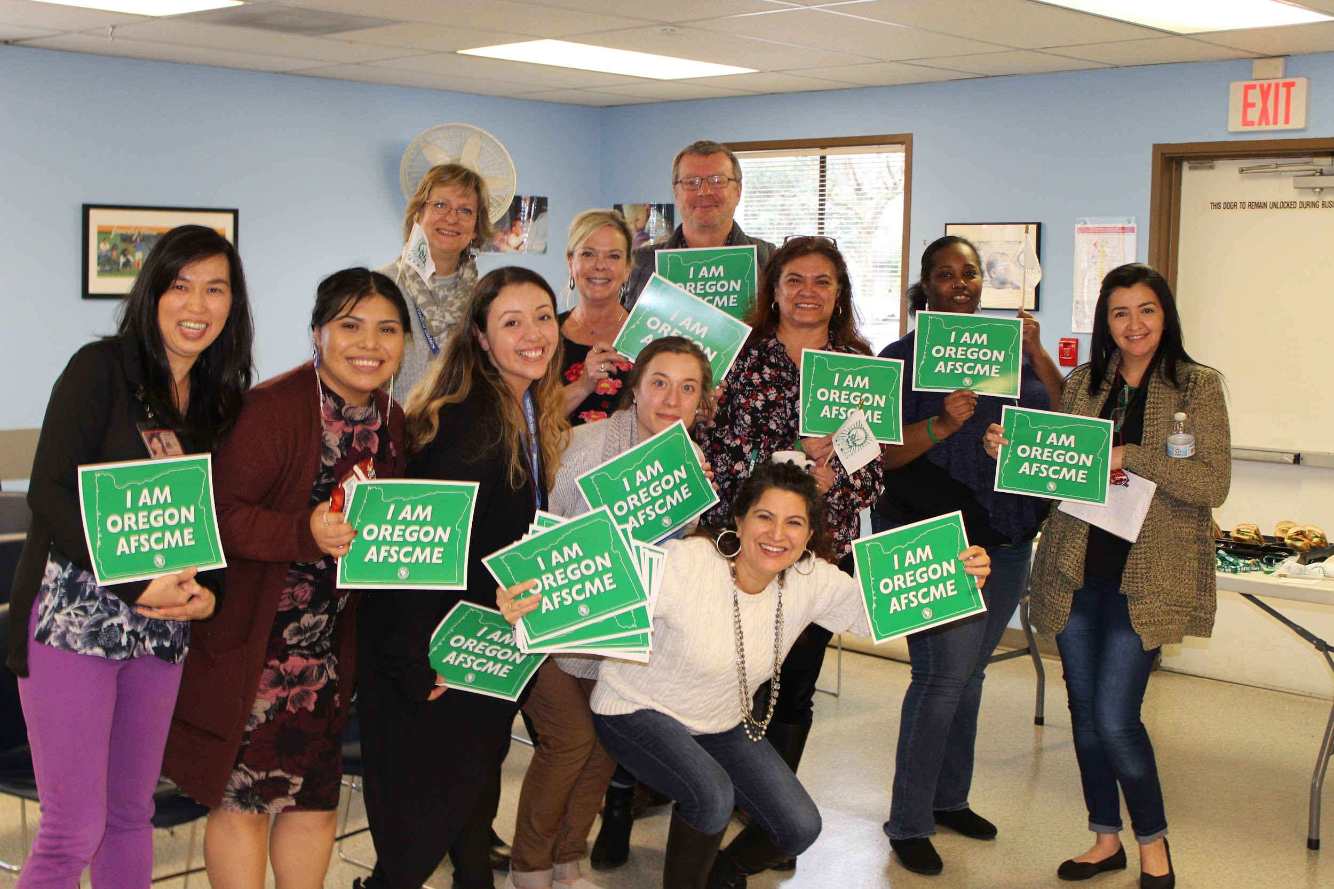
DEI in the Budget
For the 2022 budget year, there is a line item for Diversity, equity and inclusion work. This includes:
Lost time to participate ~300 hours
Budget for meals ~$1k

Slide 7
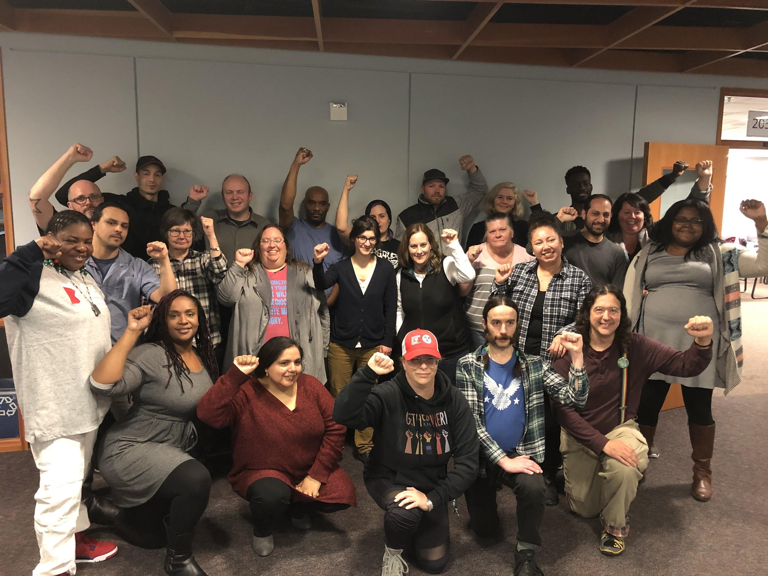
What’s Next
Microaggressions Response Team
Equity Committee
Liaisons-ERG’s
DEI Office Hours
Caucus Structure/Expectation
Trainings
Have questions or want to get involved, email dei@afscmelocal88.org

