Slide 1
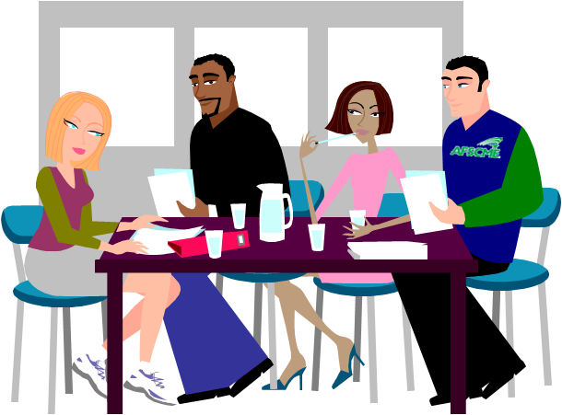
Meet the Local
Meet the Local
Welcome to our Local meeting. My name is Kate, and I'm the Chair. Let's go around the table and introduce ourselves.
Jeff Johnson here.
Hi I'm Judy Williams.
I'm Brian Smith. Glad you are here.

Slide 2
FAQ = Frequently Asked Question
FAQ = Frequently Asked Question
First, seek recognition from the Chair, by raising your hand or standing. Clearly state the motion, which is a formal proposal to take action. A long, complex motion should be in writing.
How do you make a motion at a meeting?

Slide 3
Getting recognition
Getting recognition
The Chair recognizes Judy.
Madam chair!

Slide 4
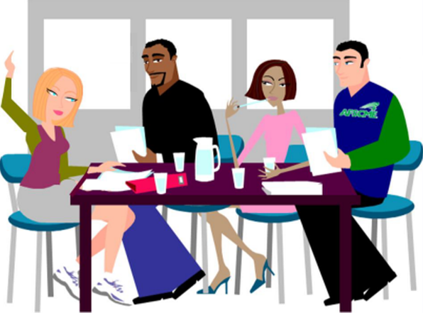
Making a motion
Making a motion
Madam chair, I'd like to make a motion…
The Chair recognizes Judy.
Jeff
Brian
Kate
Judy

Slide 5
Making a motion
Making a motion
I move that we adopt the recommendation of the PEOPLE Committee to sponsor a "Bowling Night with Elected Officials" next month.
Is there a second?

Slide 6
FAQ = Frequently Asked Question
FAQ
FAQ = Frequently Asked Question
The motion must be seconded in order to demonstrate that at least two members want to discuss the motion.
The member who seconds the motion does not need to be recognized by the Chair. The member may simply call out "second."
What happens to a motion?

Slide 7
FAQ
FAQ
FAQ = Frequently Asked Question
The Chair states the motion exactly as it was presented. This ensures that members know the proposal to be discussed.
Generally, the maker of the motion speaks first. Common practice is to alternate discussion between speakers in favor of the motion and speakers opposed to it.
How is a motion discussed?

Slide 8
Debating the motion
Debating the motion
Madam Chair, the Committee's idea to host an event with elected officials is very innovative. Some elected officials just might show up.
The Chair recognizes Judy.

Slide 9
Debating the motion
Debating the motion
The Chair recognizes Brian.
I oppose this motion because I don't think we can recruit enough people to attend the bowling thing.

Slide 10
Amending a Motion (Changing a Motion)

Slide 11
FAQ
FAQ
FAQ = Frequently Asked Question
If you want to change a motion, you must move to amend the motion. The new motion is called an amendment. You state your motion with your new amended language.
The Chair asks if there is second to the motion. If your amendment is seconded,
How do I change a motion?
The Chair follows the procedure on the next slide.

Slide 12
Amending a motion
Amending a motion
The body resumes dealing with the original motion.
If members vote against
the amendment
An amendment is made
to the motion and seconded.
The body has a new motion to deal with. It is the original motion as amended.
A motion is made and seconded.
If members vote to approve
the amendment

Slide 13
Voting on the amendment
Voting on the amendment
We must first vote on the amendment, then we will go back and vote on the main motion.

Slide 14
Voting on the amendment
Voting on the amendment
All those in favor of the amendment that the Local will sponsor a "Picnic with Elected Officials," say "aye," those opposed say "no."
No
Aye
Aye

Slide 15
Debating the main motion
Debating the main motion
The amendment passes. We are now back on the main motion as amended. The Local will sponsor a "Picnic with Elected Officials" next month.

Slide 16
Weird Stuff

Slide 17
FAQ
FAQ = Frequently Asked Question
You can move to "table the motion." If there is a second, the Chair will call for a vote without further debate.
Or you can move to "refer to the motion to a committee." This also requires a second, but it can be debated and amendments may be offered.
What if I want to stop debate on a motion because more details are needed?

Slide 18
FAQ
FAQ = Frequently Asked Question
Another member may clearly state "point of order."
What if a member is getting off track and is no longer discussing the motion?

Slide 19
Point of order
Point of order
Brian, please state your point of order.
Jeff is not speaking on the motion.

Slide 20
Voting and Ending the Meeting

Slide 21
FAQ
FAQ = Frequently Asked Question
A member makes a motion to "call the question," which means to end debate.
This motion requires a second and is not debatable.
A vote to end debate requires a 2/3 vote.
What's the most common way for a member to end debate?

Slide 22
FAQ = Frequently Asked Questions
A member makes a motion to adjourn and a majority vote is required.
The motion to adjourn is not debatable.
How does the meeting end?

Slide 23
Small Group Discussions
How do you make members feel comfortable and included in Union Meetings?

